Slide 1
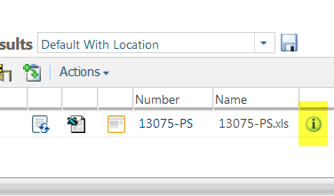
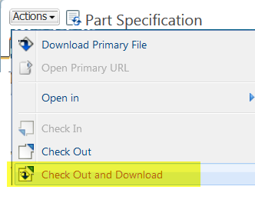
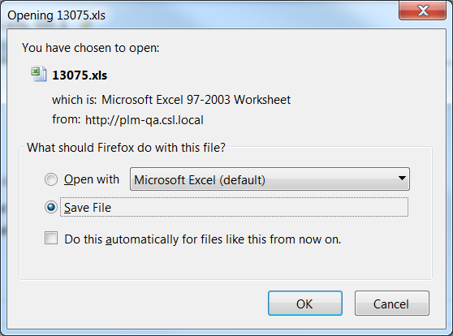


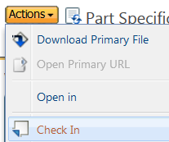

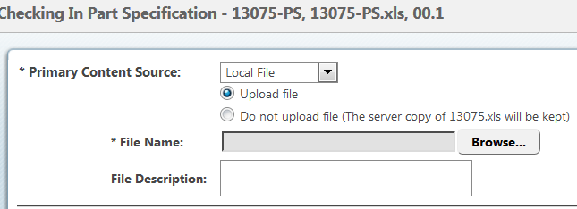
How to Edit a Document in Windchill
a. Find your document and click the info page button.
1 Find Doc
a
b. Click Actions.
c. Check-out and Download
b
2 Check-out
c
In the save dialog box:
d. Choose save file.
e. Click OK
Edit the document locally on your computer. Save it then go to point 4.
CAUTION: Read the instructions in sequence. Actions in point 2 should not be done before completing point 1.
3 Save file
d
e
Tool Tips
Instead of using the move function you can use the Cut function.
f
NOTE: If you changed your mind you can click “undo check-out” to keep the existing file as is.
From the info page. (a)
f . Click Actions
g. Check-in
h. Browse to select the latest file.
i. Click OK
g
4 Check-in
h

